Slide 1

Predicting Delay in Flights using Big Data and Machine learning
Submitted by Remon Roshdy rr3531

Slide 2

Table of Content
Topics | Page Number
Purpose of Document | 1
Problem statement and motivation | 2
Dataset Description | 3-5
Approach | 5
Architecture Input Data Apache Pyspark Data Visualization Machine Learning library | 6
Exploratory Data analysis Missing Data Duplicate Data Relevant Columns Columns with one value Correlation Matrix Once hot encoding Sampling | 7-10
Machine Learning models Logistic Regression Random Forest | 11-12
Reference | 13

Slide 3
Purpose
This document details the implementation details carried out to analyze the flight arrival delays
The document describes the problem statement, approach, analysis, and the proposed architecture
The code and graphical representation of the analysis have been explained in detail for clarity

Slide 4

Problem Statement and Motivation
Flight delay for the airport affects the traditional operation of the airport Flight delay for the airlines brings huge economic losses and also affects the reputation of the airline
Reducing flight delay helps to decrease costs and helps to improve the standard of the service provided to customers
We want to be able to predict, based on historical data, the arrival delay of a flight using only information available before the flight takes off

Slide 5
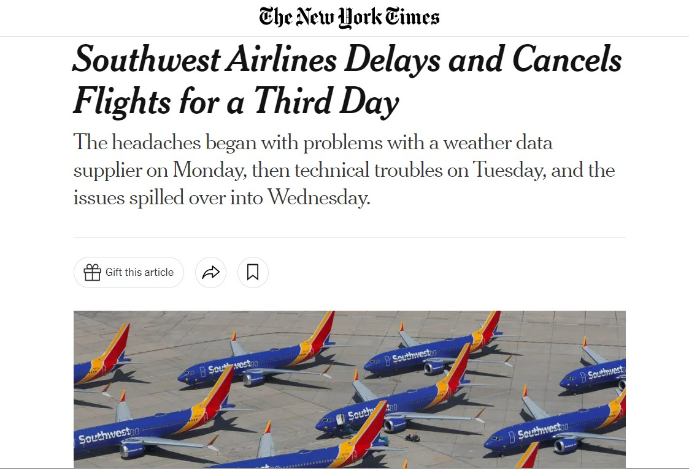
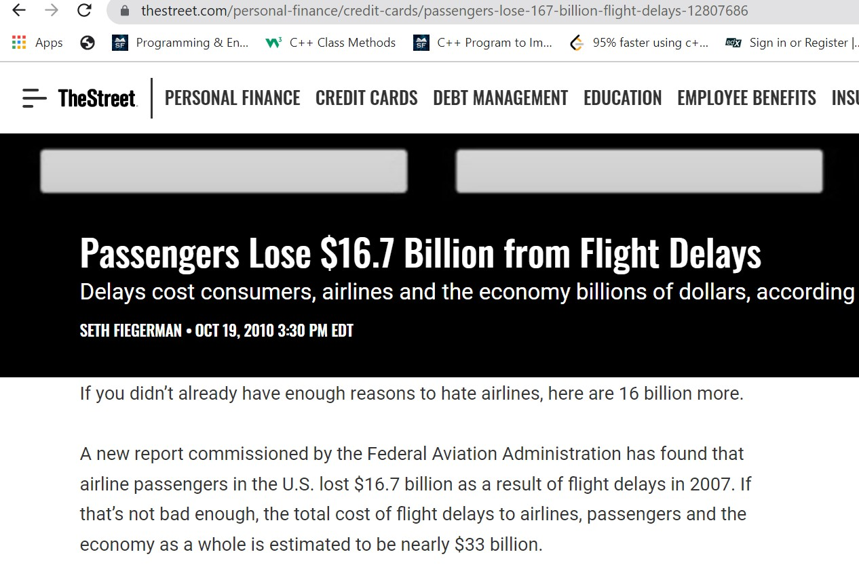
IN the News

Slide 6
Case study
In this study, domestic flights data between Jan 2008 and Dec 2008 are used as a case study
Note that the extracted dataset does not contain the international flights which have a relatively low delay ratio
The collected dataset, which is owned by The U.S. Department of Transportation's Bureau of Transportation Statistics , contains a combined data of flights, origin of flight, destination, and distance, etc

Slide 7

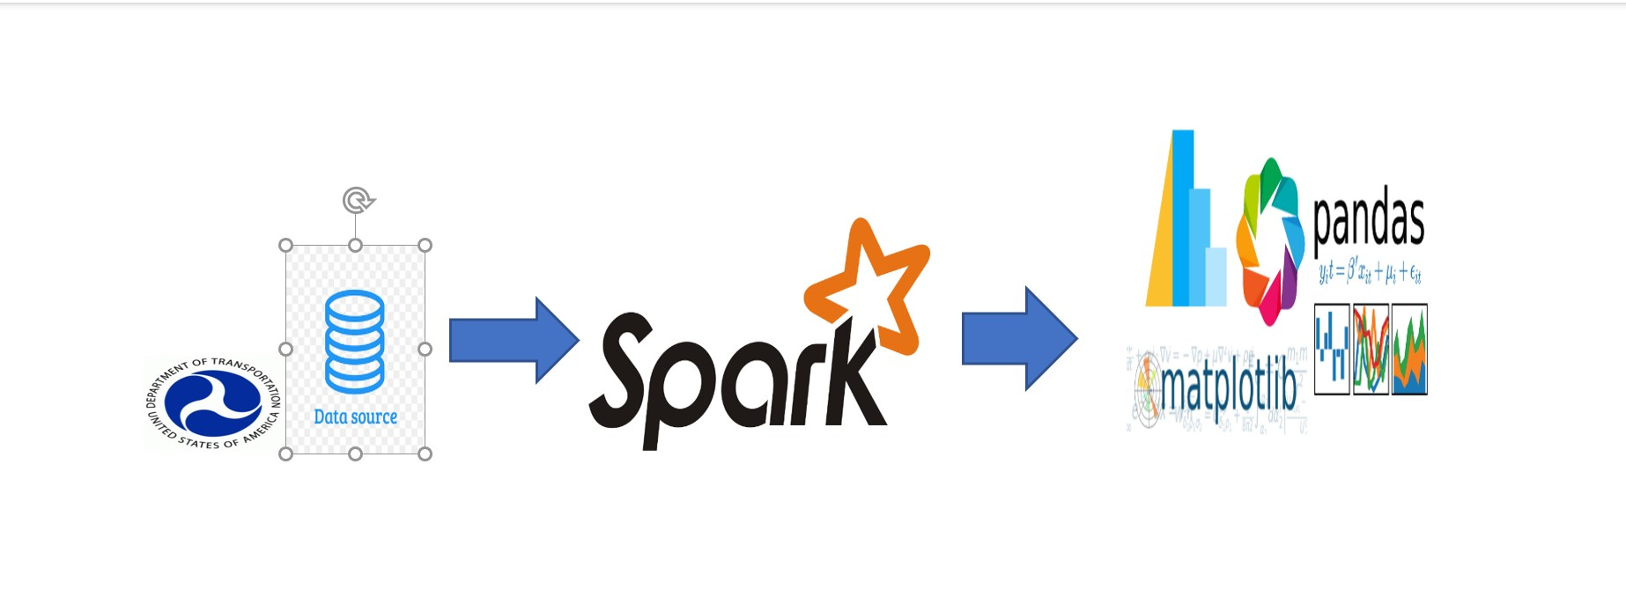
Technology Used and Architectural

Slide 8
The components used in the above architecture and their use is described below
Input Data Source data source coming from US department of transportation Spark is the heart of the processing in this architecture
Spark is the heart of the processing in this architecture, can handle large Data set , our file has more than 2.3 Million rows
A tool like Plotly is used to show relevant information about the project

Slide 9
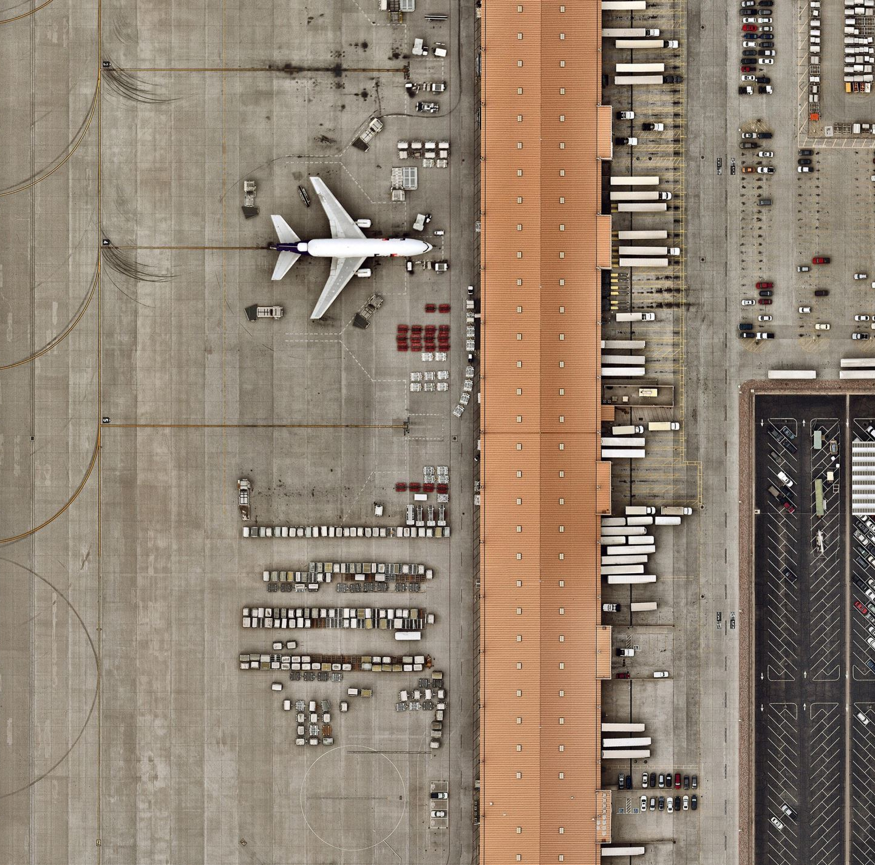
Dataset Description
The results presented in this paper were obtained using data from https://dataverse.harvard.edu/dataset.xhtml?
We had access to a large dataset with 2.4 Million entries of data of commercial flights in the year
The dataset provides information about flights by date of flight, the airport the flight will take off from, flight number, distance, departure, and arrival time

Slide 10
There are 29 fields in the dataset, and the main fields are below
The forbidden column in the table represents those variables from the dataset that can't be included since their values are only known once the plane has already taken off
Hence, if we use the forbidden variables, all the algorithms would return unreliable results
The forbidden columns include ArrTime, ActualElapsedTime, AirTime, TaxiIn, Diverted, CarrierDelay, WeatherDelay, NASDelay, SecurityDelay andLateAircraftDelay

Slide 11
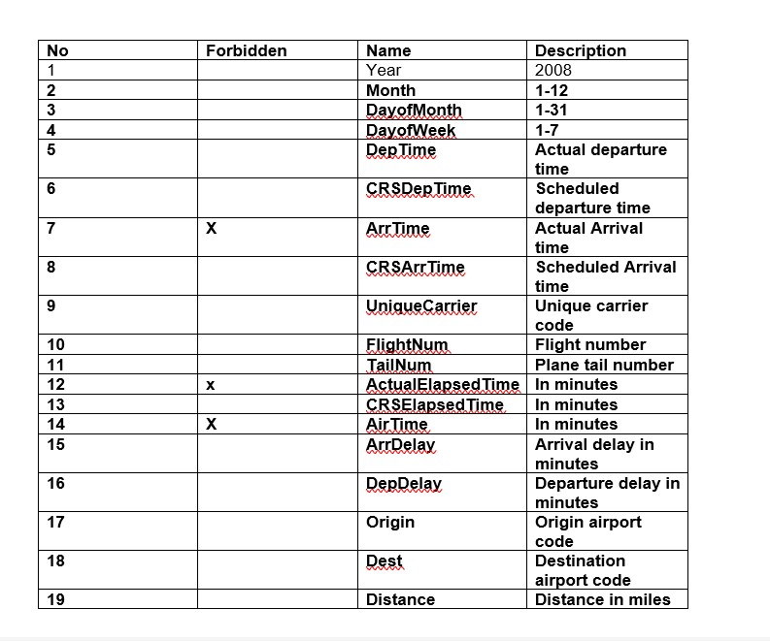
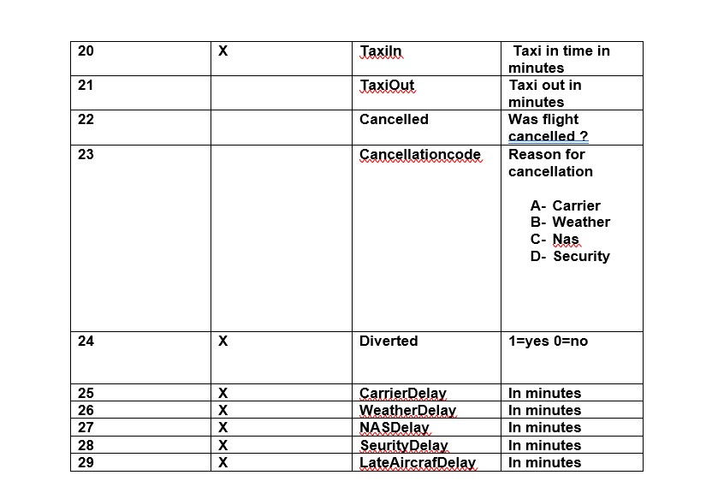

Slide 12
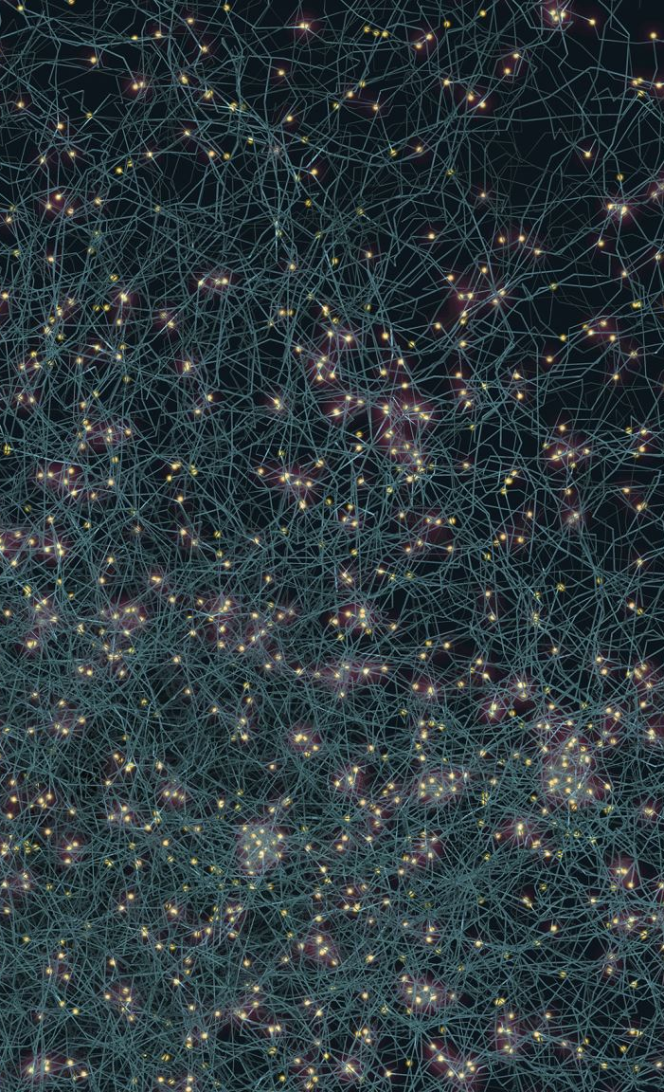
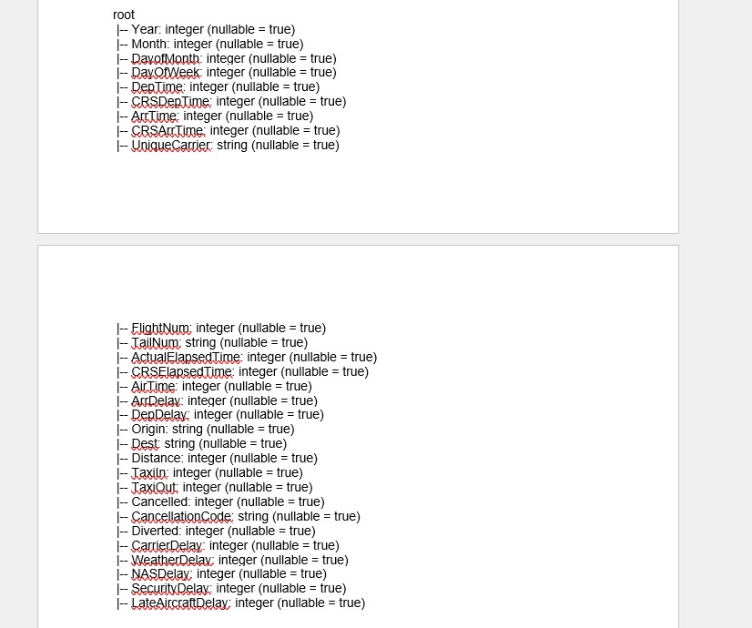
See Below Dataset Schema

Slide 13

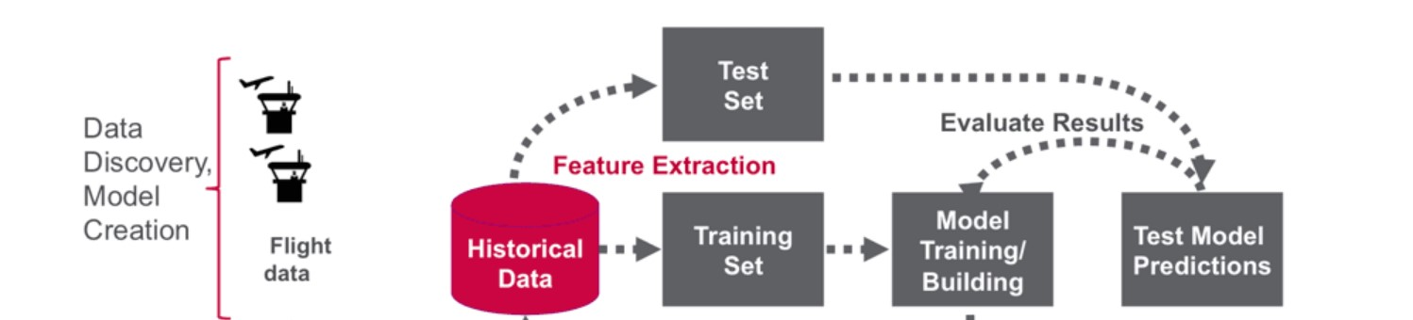
Methodology
In this section, we review the dataset available to us and after proper cleaning of the data we run different analytical methods to find insights of the data
For example, the various variables responsible for the arrival delay of flights
After the exploratory analysis of the available data, we make the data run across certain predictive analysis methods like Logistic Regression and Random forest model and try to predict the flight arrival delay with the highest precision and accuracy

Slide 14

Exploratory Data Analysis

Slide 15
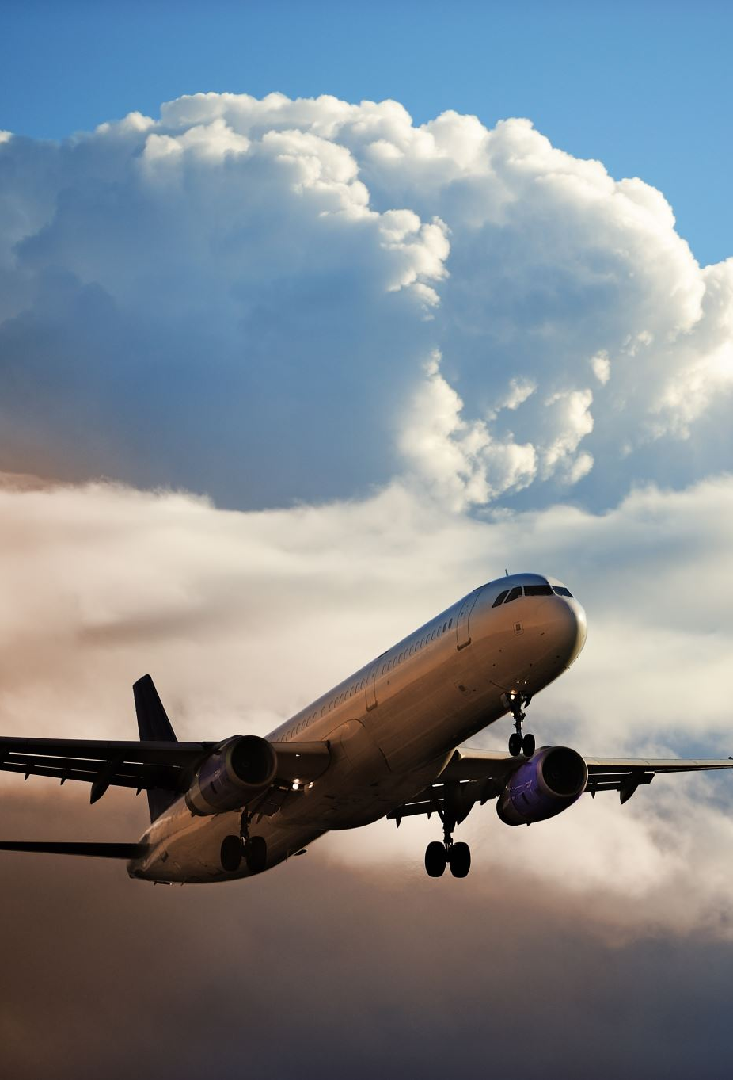
Define Delay
Our focus is to predict the value of ArrDelay We define Arrival delay if the flight is late more than 15 minutes of its Scheduled Arrival

Slide 16

Forbidden Variables
In order to perform the required study properly, there are some variables from the dataset that can't be included since their values are only known once the plane has already taken off
If we used the forbidden variables, all the algorithms would return unreliable results
For this reason, all the columns ArrTime, ActualElapsedTime, AirTime, TaxiIn, Diverted, CarrierDelay, WeatherDelay, NASDelay, SecurityDelay and LateAircraftDelay were dropped

Slide 17
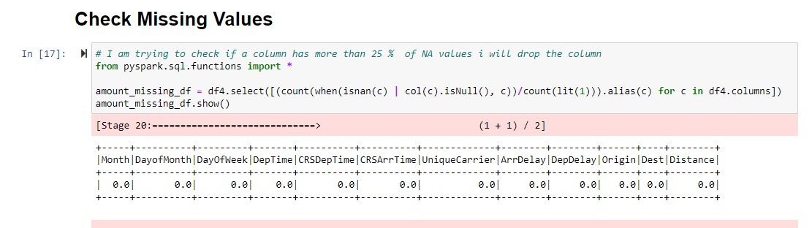
Reading the file
Remove Duplicates
Delete Rows when Delay time is not available
Delet columns where it has only 1 distinct value
Check for missing values > 25% drop it

Slide 18
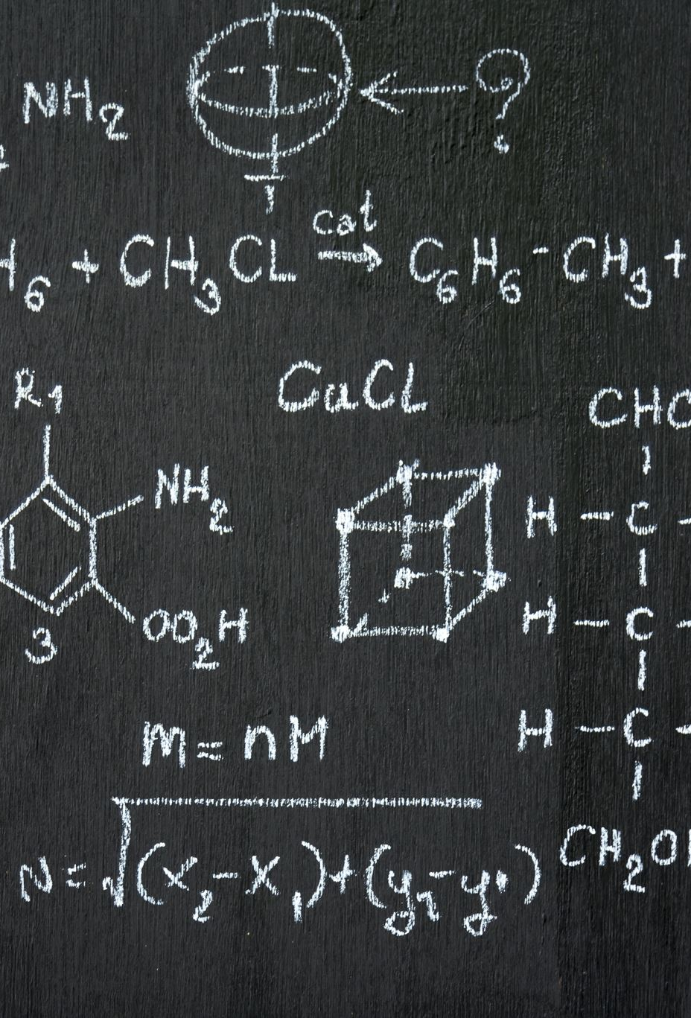
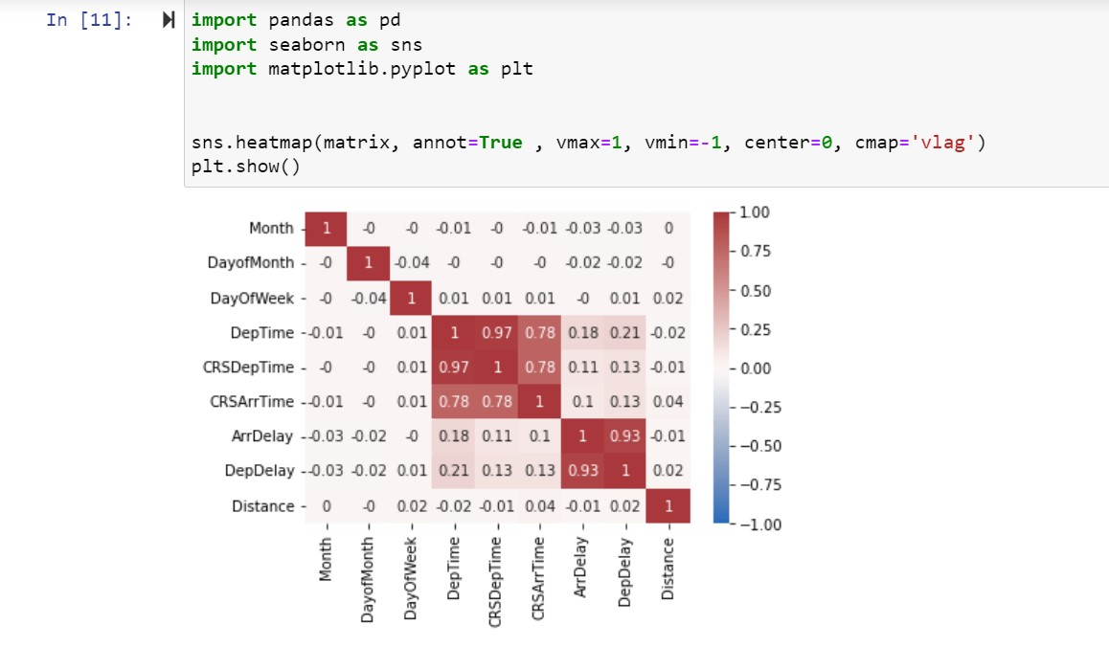
Correlation of features
From the correlation Matrix we can see the strongest correlations are with DepDelay and TaxiOut , it also show some but much less correlation with depTime, CRSDEpTime and CRSArrTime

Slide 19

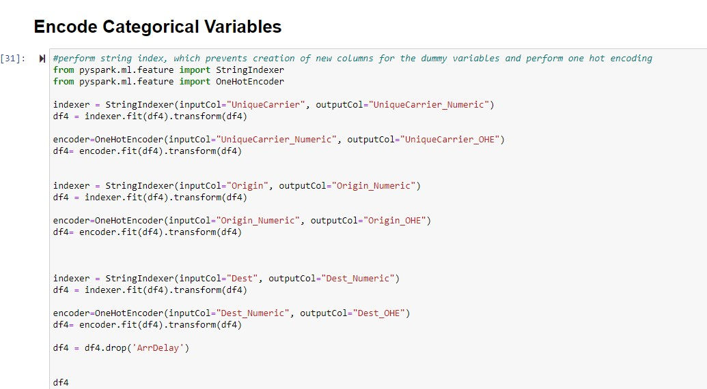
One Hot encoding Categorical Values

Slide 20
ML Models used
Logistic Regression
Random Forest

Slide 21
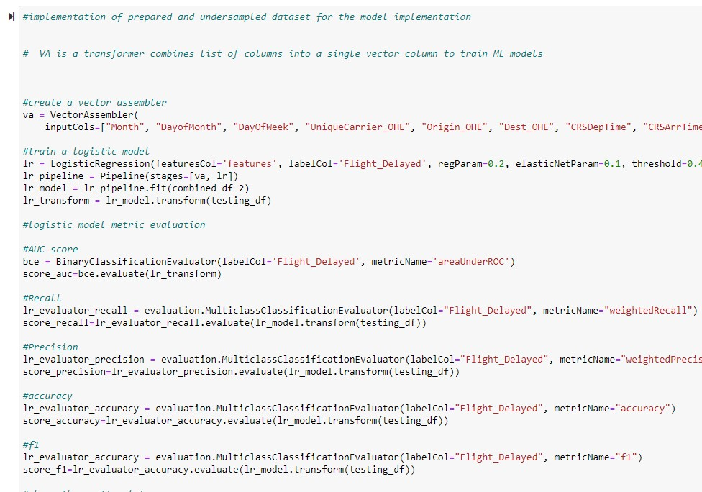

Slide 22
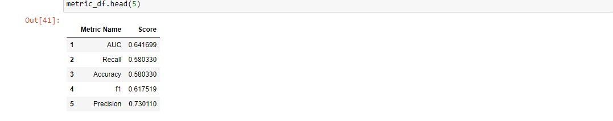
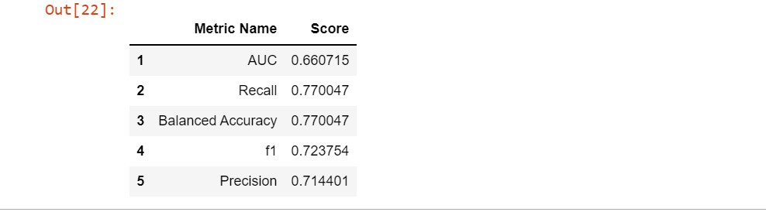
Evaluation of Models
Logistic Regression
Random forest

Slide 23

Conclusion
Since we choose to run the logistic Regression Model using 12 features And Also run the model with 5 features with the help of correlation matrix
In general logistic regression performs better when the number of noise variables is less than or equal to the number of explanatory variables and random forest has a higher true and false positive rate as the number of explanatory variables increases in a dataset
As Random forest model takes random samples forming many decision tress and take the average of those decisions to form a more refined model

Slide 24

References
https://stackoverflow.com/questions/58995226/one-hot-encode-of-multiple-string-categorical-features-using-spark-dataframes
https://github.com/ssingh56/Predicting_Flight_delays_cancellations/blob/master/EDA%2BDELAY.ipynb
https://medium.com/analytics-vidhya/using-machine-learning-to-predict-flight-delays-e8a50b0bb64c
https://www.analyticsvidhya.com/blog/2019/11/build-machine-learning-pipelines-pyspark/
https://datagy.io/python-correlation-matrix/

